Slide 1
ECE408 / CS483 Fall 2016 Applied Parallel Programming Lecture 24: Application Case Study – Deep Learning

Slide 2
Machine Learning
An important way of building applications whose logic is not fully understood.
No catastrophical consequence for incorrect output
Use labeled data – data that come with the input values and their desired output values – to learn what the logic should be
Capture each labeled data item by adjusting the program logic
Learn by example!
Training Phase
The system learns the logic for the application from labeled data.
Deployment (inference) Phase
The system applies the learned program logic in processing data

Slide 3
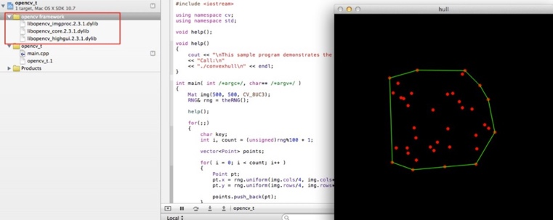
Deep Learning in Computer Vision
ImageNet
Traditional CV
Deep Learning
Traditional Computer Vision
Experts + Time
Deep Learning Object Detection
DNN + Data + HPC
Deep Learning Achieves “Superhuman” Results
Slide courtesy of Steve Oberlin, NVIDIA

Slide 4
Recent Explosion of Deep Learning Applications
GPU computing hardware and programming interfaces such as CUDA has enabled very fast research cycle of deep neural net training
Computer Vision, Speech Recognition, Document Translation, Self Driving Cars, …
Most involve logic that were previously not effectively constructed with imperial programming
Using big labeled data to train and specialize DNN based classifiers
Deriving a large quantity of quality labeled data is a challenge

Slide 5
Behind the Scenes
In 2010 Prof. Andreas Moshovos at University of Toronto adopted the ECE498AL Programming Massively Parallel Programming Class
Several of Prof. Geoffrey Hinton’s graduate students took the course
These students developed the GPU implementation of the DNN that was trained with 1.2M images to win the ImageNet competition

Slide 6
Background: Combinations Logic Specification – Truth Table
a’
a
b’
b
c’
c
Input |  |  | output
a | b | c
0 | 0 | 0 | 0
0 | 0 | 1 | 1
0 | 1 | 0 | 1
0 | 1 | 1 | 0
1 | 0 | 0 | 1
1 | 0 | 1 | 0
1 | 1 | 0 | 0
1 | 1 | 1 | 1

Slide 7
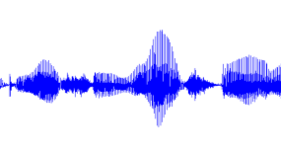
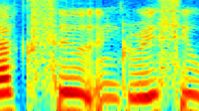
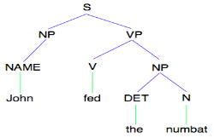
Different modalities of Real-world Data
Images/video
Image
Vision features
Detection
Audio
Audio
Audio features
Speaker ID
Text classification, machine translation, information retrieval, ....
Text
Text
Text features
Slide courtesy of Andrew Ng, Stanford University

Slide 8
What if we did not know the truth table?
Look at enough observation data to construct the rule
000 → 0
011 → 0
100 → 1
110 → 0
If we have enough observational data to cover all input patterns, we can construct the truth table and derive the logic!
Alien story.

Slide 9
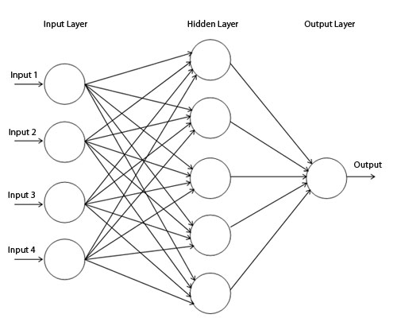
Multilayer Perceptron Synaptic Weights
Universal for function approximation
SUPERVISED
TRAINING
CLASSIFICATION
SYNAPTIC
WEIGHTS
SYNAPTIC
WEIGHTS
[Cybenko, 1989; etc.]
Combinational Logic of AI
9

Slide 10
LeNet-5, a convolutional neural network for hand-written digit recognition
This is a 1024*8 bit input, which will have a truth table of 2 ⁸¹⁹⁶ entries

Slide 11
Forward Propagation Path of a Convolution Layer
All input feature maps contribute to all output feature maps. One convolution mask is provided for each input-output combination.

Slide 12
Example of the Forward Path of a Convolution Layer
7
5
2
1*0+ 1*2 +
1*0 + 1*3
1*0+ 1*2 +
1*0 + 1*3
1*1+ 1*2 +
2*1 + 2*1

Slide 13
LeNet-5, a convolutional neural network for hand-written digit recognition. LeNet-5, a convolutional neural network for hand-written digit recognition

Slide 14
Sequential Code for the Forward Path of a Convolution Layer
void convLayer_forward(int M, int C, int H, int W, int K, float* X, float* W, float* Y)
{
int m, c, h, w, p, q;
int H_out = H – K + 1;
int W_out = W – K + 1;
for(int m = 0; m < M; m++) // for each output feature map
for(int h = 0; h < H_out; h++) // for each output element
for(int w = 0; w < W_out; w++) {
Y[m, h, w] = 0;
for(int c = 0; c < C; c++) // sum over all input feature maps
for(int p = 0; p < K; p++) // KxK filter
for(int q = 0; q < K; q++)
Y[m, h, w] += X[c, h + p, w + q] * W[m, c, p, q];
}
}

Slide 15
Sequential code for the Forward Path of a Sub-sampling Layer
void poolingLayer_forward(int M, int H, int W, int K, float* Y, float* S)
{
for(int m = 0; m < M; m++) // for each output feature maps
for(int h = 0; h < H/K; h++) // for each output element
for(int w = 0; w < W/K; w++) {
S[m, x, y] = 0.;
for(int p = 0; p < K; p++) { // loop over KxK input samples
for(int q = 0; q < K; q++)
S[m, h, w] += Y[m, K*h + p, K*w + q] /(K*K);
}
// add bias and apply non-linear activation
S[m, h, w] = sigmoid(S[m, h, w] + b[m])
}
}

Slide 16
Any Questions?

